Slide 1
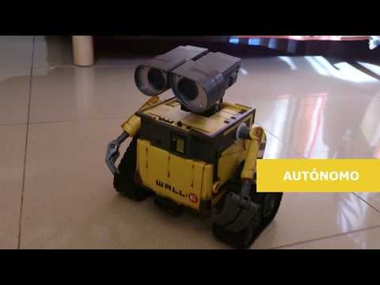
Arduinos
Intro and Piano

Slide 2
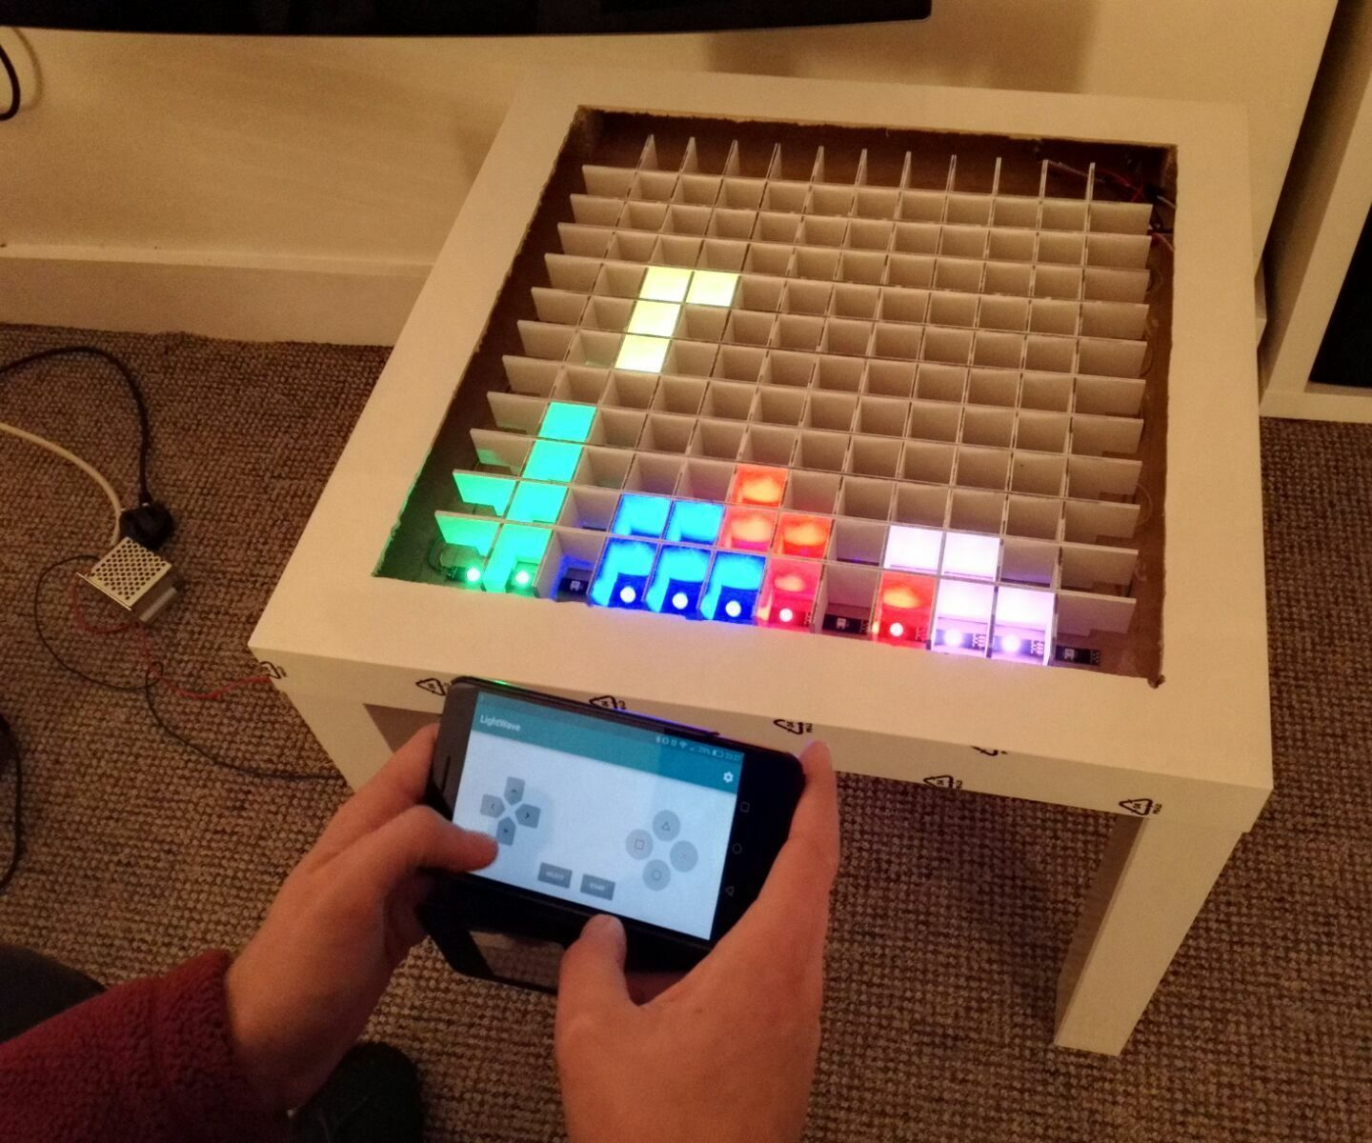
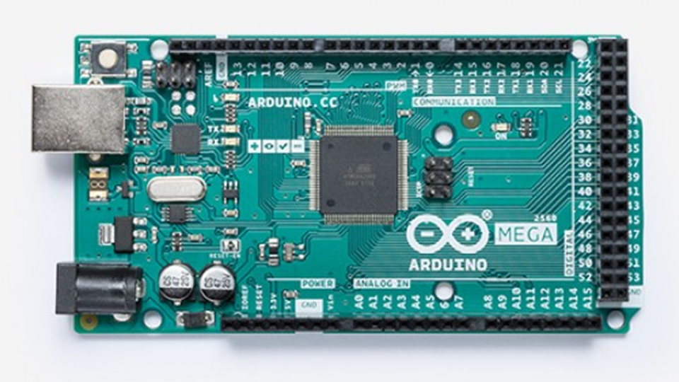
What is it?
Open-source electronics platform
Can read inputs - light on a sensor, a finger on a button, or a Twitter message
Produce outputs - activating a motor, turning on an LED, publishing something online
Uses the Arduino Programming Language
Notes:
https://www.arduino.cc/en/Guide/Introduction

Slide 3
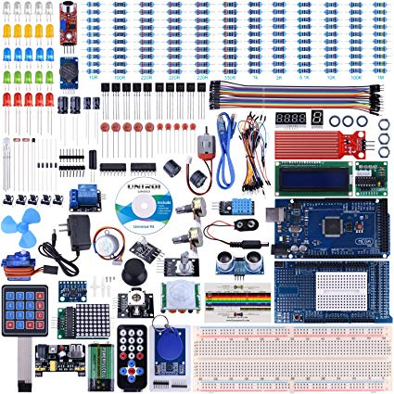
Arduino Mega
Kits are used in the IOT class. Please do not lose any parts!
We will be building three projects
LED with button
LED multiple fade
Mini Piano
If there is time after this you can try any tutorial you would like.
Notes:
https://www.arduino.cc/en/Tutorial/Button
https://www.arduino.cc/en/Tutorial/AnalogWriteMega

Slide 4
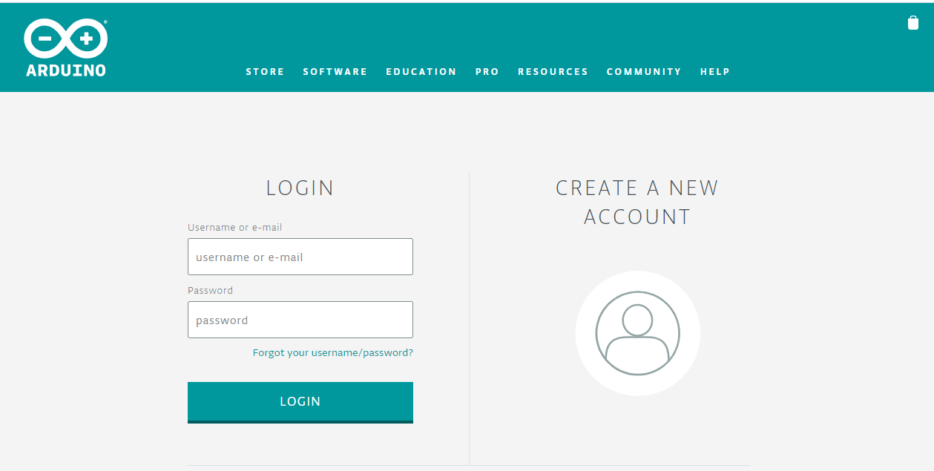
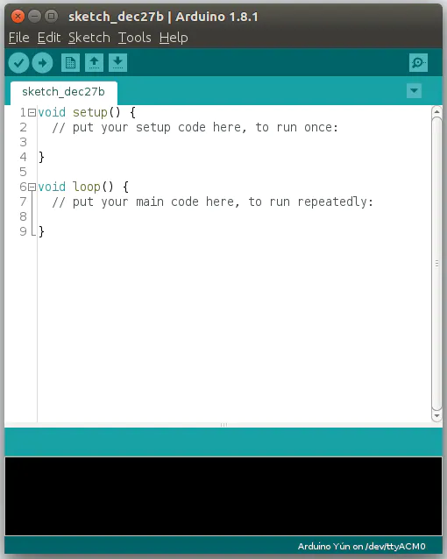
Setting up
Arduino Software is already installed on your desktop.
Online Editor is available as well (Must create a login)

Slide 5
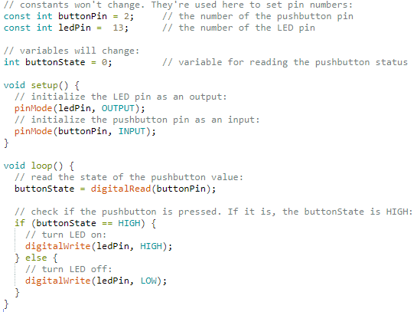
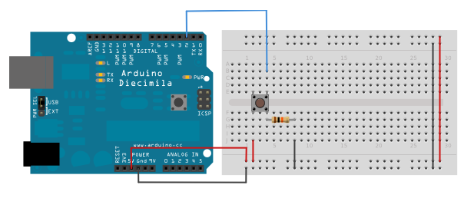
LED with Button
Notes:
https://www.arduino.cc/en/Tutorial/Button

Slide 6
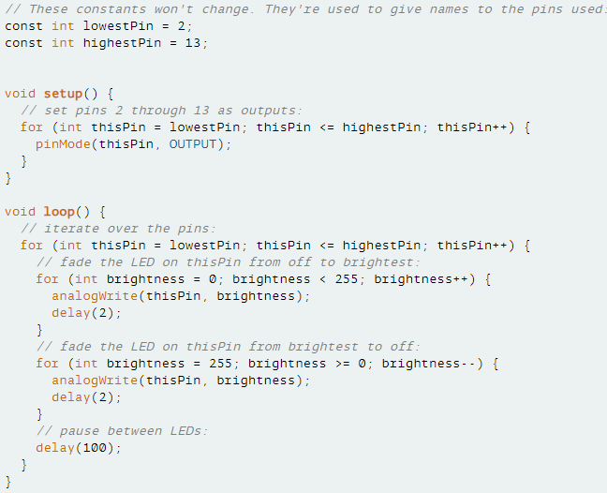
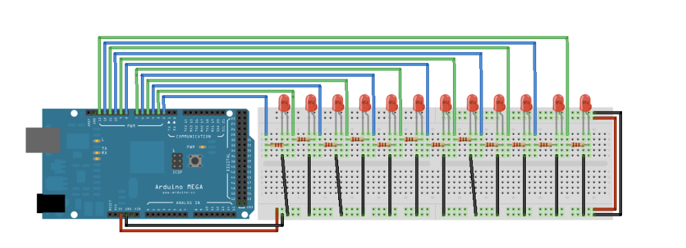
LED Multiple fade
Notes:
https://www.arduino.cc/en/Tutorial/AnalogWriteMega

Slide 7
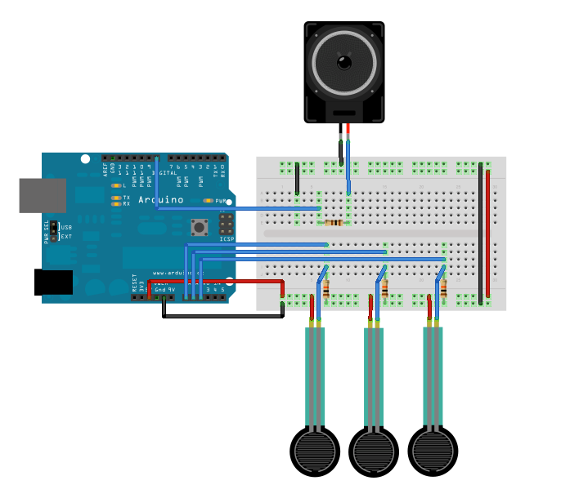
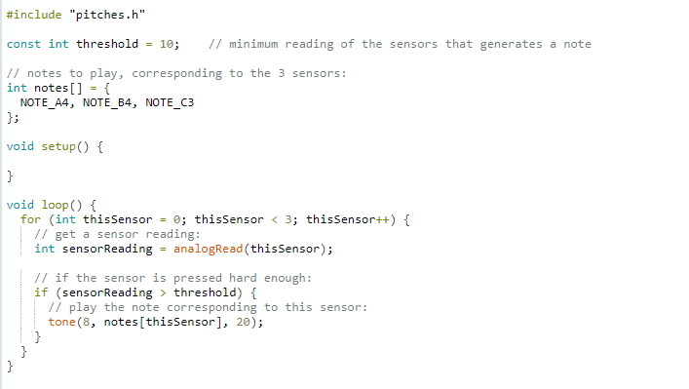
PIANO
Notes:
https://www.arduino.cc/en/Tutorial/toneKeyboard

Slide 8
After…
For more projects check out the other built in examples
Please clean up your kits.
If they are not returned as you got them we will not be allowed to do another session.

